Slide 1
Threads & Scheduling

Slide 2
Chapter 4: Threads
Overview
Multicore Programming
Multithreading Models
Thread Libraries
Implicit Threading
Threading Issues
Operating System Examples

Slide 3
Objectives
To introduce the notion of a thread—a fundamental unit of CPU utilization that forms the basis of multithreaded computer systems
To discuss the APIs for the Pthreads, Windows, and Java thread libraries
To explore several strategies that provide implicit threading
To examine issues related to multithreaded programming
To cover operating system support for threads in Windows and Linux

Slide 4
Classical Thread Model
3 processes with 1 thread each
1 process with 3 threads

Slide 5
Motivation
Most modern applications are multithreaded
Threads run within application
Multiple tasks with the application can be implemented by separate threads
Update display
Fetch data
Spell checking
Answer a network request
Process creation is heavy-weight while thread creation is light-weight
Kernels are generally multithreaded
Notes:
-Solaris and Linux kernels are multithreaded. Threads for interrupt handling, memory management etc.
In a heavyweight process, new processes are created to perform the work in parallel. Here (for the same application or service), you would see multiple processes running. Each heavyweight process contains its own address space. Communication between these processes would involve additional communications mechanisms such as sockets or pipes. Since threads use the same code section, data section and OS resources, less overall resources are used.

Slide 6
Multithreaded Server Architecture

Slide 7
Benefits
Responsiveness – may allow continued execution if part of process is blocked, especially important for user interfaces
Resource Sharing – threads share resources of process
Economy – ten times cheaper than process creation, 30 times thread switching lower overhead than context switching of process
Scalability – process can take advantage of multiprocessor architectures On multiprocessor architectures, a multithreaded process can assign threads to different processors for real parallelism; a single threaded process, on the other hand, cannot use more than one processor at a time.
Notes:
-Responsive examples given before e.g. web browser blocked in one thread (image displaying) but performing in another (downloading rest of the page)
-Sharing code and data in the same address space. Also share resources of process.
-Economy: Allocating memory and resources is costly. Threads share so economical. Reduces creation and context-switching time. Allocating In Solaris: creating a process
is 5 times slower than a thread; context switching of processes is 30 times slower than context switching of threads.
-Scalability: Such economies become more marked when we increase the number of threads. E.g.

Slide 8
Multicore Programming
Multicore or multiprocessor systems putting pressure on programmers, challenges include:
Dividing activities
Balance
Data splitting
Data dependency
Testing and debugging
Parallelism implies a system can perform more than one task simultaneously
Concurrency supports more than one task making progress
Single processor / core, scheduler providing concurrency
Notes:
-Testing and debugging: When a program is running in parallel on multiple cores, many different execution paths are possible. Testing and debugging such concurrent programs is inherently more difficult than testing and debugging single-threaded applications.
-With a lot of power comes a lot of responsibility:
http://www.techiehq.net/pc-technical-talk/do-multi-core-cpus-work-practice-windows-24952.html
Interrupt handling in Unix-based: http://www.alexonlinux.com/smp-affinity-and-proper-interrupt-handling-in-linux
How the sequence of instructions is important, thus hindering parallelism: http://en.wikipedia.org/wiki/Data_dependency
Difference between parallelism and concurrency, Such processes are running concurrently, but not in parallel. Gives illusion by context switching

Slide 9
Multicore Programming (Cont.)
Types of parallelism (usually applications use a hybrid model)
Data parallelism – distributes subsets of the same data across multiple cores, same operation on each
Task parallelism – distributing threads across cores, each thread performing unique operation
As number of threads grows, so does architectural support for threading
Notes:
-Data parallelism: Consider, for example, summing the contents of an array of size N. On a single-core system, one thread would simply sum the elements [0] . . . [N − 1].
On a dual-core system, however, thread A, running on core 0, could sum the elements [0] . . . [N/2 − 1] while thread B, running on core 1, could sum the elements [N/2] . . . [N − 1]. The two threads would be running in parallel on separate computing cores.
-Task parallelism: involves distributing not data but tasks (threads) across multiple computing cores. Each thread is performing a unique operation. Consider again our example above. In contrast to that situation, an example of task parallelism might involve two threads, each performing a unique statistical operation on the array of elements in parallel.
-Hardware threads: This support means that multiple threads can be loaded into the core for fast switching. Might mean duplicating registers for fast thread switching (one set of registers per thread) and also duplicating program counter. The thread IDs of each instruction in the pipeline can also be tracked by each pipeline stage.
http://en.wikipedia.org/wiki/Multithreading_(computer_architecture)

Slide 10
Concurrency vs. Parallelism
Concurrent execution on single-core system:
Parallelism on a multi-core system:

Slide 11
Threads and Processes
Single Threading
Multi-Threading

Slide 12
Single and Multithreaded Processes

Slide 13
Thread vs. Process
Notes:
-Single thread processes have all items in both columns. A multi-threaded one has the division as above.
-Signals are used in POSIX-compliant OSes to signal processes about some events.
They can be synchronous or asynchronous. e.g. divide by zero, <Ctrl-C> by user, illegal memory access.
The process can ignore the signal, use default signal handler, or use a specific signal handling function
defined by it. We’ll discuss them later on.

Slide 14
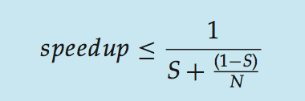
Amdahl’s Law
Identifies performance gains from adding additional cores to an application that has both serial and parallel components
S is serial portion
N processing cores
That is, if application is 75% parallel / 25% serial, moving from 1 to 2 cores results in speedup of 1.6 times

Slide 15
Application benefits of threads
Consider an application that consists of several independent parts that do not need to run in sequence
Each part can be implemented as a thread
Whenever one thread is blocked waiting for I/O, execution could switch to another thread of the same application (instead of switching to another process)

Slide 16
Benefits of Threads
Example 1: File Server on a LAN
Needs to handle many file requests over a short period
Threads can be created (and later destroyed) for each request
If multiple processors: different threads could execute simultaneously on different processors
Example 2: Spreadsheet on a single processor machine:
One thread displays menu and reads user input while the other executes the commands and updates display

Slide 17
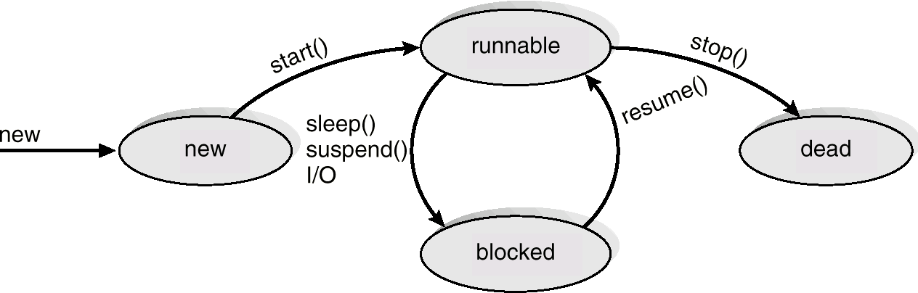
Thread States
Four key states: new, Runnable(Ready), Blocked, Dead
Termination of a process terminates all threads within the process
Because the process is the environment the thread runs in

Slide 18
Thread Operations
Block (yield, suspend):
Save PC, registers, etc. and allow other thread(s) to run
Could “block” whole process if making system call which requires kernel service, otherwise it’s a single thread being suspended.
Unblock (wake):
IO finishes, or another relinquishes control, thread moves to Ready queue
Finish (terminate):
Deallocate context (stacks etc.)
Notes:
Yield is a static method which is essentially used to notify the system that the current thread is willing to "give up the CPU" for a whilesleep() causes the thread to definitely stop executing for a given amount of time; if no other thread or process needs to be run, the CPU will be idle (and probably enter a power saving mode).
yield() basically means that the thread is not doing anything particularly important and if any other threads or processes need to be run, they should. Otherwise, the current thread will continue to run
Suspend is depricated

Slide 19
User Threads and Kernel Threads
User threads - management done by user-level threads library
Three primary thread libraries:
POSIX Pthreads
Windows threads
Java threads
Kernel threads - Supported by the Kernel
Examples – all general purpose operating systems, including:
Windows
Solaris
Linux
Notes:
-Tru64 UNIX is a 64-bit UNIX operating system for the Alpha instruction set architecture (ISA), currently owned by Hewlett-Packard (HP).
-The use of kernel threads simplifies user code by moving some of the most complex aspects of threading into the kernel. The program doesn't need to schedule threads or explicitly yield the processor. User code can be written in a familiar procedural style, including calls to blocking APIs, without starving other threads.
-An API (system calls) to the kernel thread facility exists.
-To see these threads, run ps ax and note all of the processes in [square brackets].
-http://en.wikipedia.org/wiki/File:Linus-linux.ogg (pronunciation)

Slide 20
Multithreading Models
Many-to-One
One-to-One
Many-to-Many
Notes:
http://en.wikipedia.org/wiki/Thread_(computer_science)#Models
http://www.cs.brown.edu/research/thmon/thmon2a.html
-A kernel thread is a kernel entity, like processes and interrupt handlers; it is the entity handled by the system scheduler. A kernel thread runs in user mode environment when executing user functions or library calls; it switches to kernel mode environment when executing system calls.
A kernel-only thread is a kernel thread that executes only in kernel mode environment. Kernel-only threads are controlled by the kernel mode environment programmer through kernel services.

Slide 21
Many-to-One
Many user-level threads mapped to single kernel thread
Thread management in user space by thread library
One thread blocking causes all to block
Multiple threads will not run in parallel on muticore system because only one may be in kernel at a time
Few systems currently use this model
Examples:
Solaris Green Threads
GNU Portable Threads
Notes:
-There has to be one kernel level thread that actually gets run on the CPU. In single-threaded processes, the process itself is the thread that gets run by the kernel.
-Context is saved on stacks of user threads. Then context pointer used to point to the stack of the current thread.
-A common solution to this problem is providing an I/O API that implements a synchronous interface by using non-blocking I/O internally, and scheduling another user thread while the I/O operation is in progress. This is called jacketing: instead of directly calling a system I/O routine, a thread calls an application-level I/O jacket routine.
Within this jacket is code that checks if the I/O device is busy. If it is, the thread enters blocked state and passes control through the threads library to another thread. When the thread later is given control again, the jacket routine checks the I/O device again. (from Stallings: p.172)
Similar solutions can be provided for other blocking system calls. Alternatively, the program can be written to avoid the use of synchronous I/O or other blocking system calls.

Slide 22
One-to-One
Each user-level thread maps to kernel thread
Creating a user-level thread creates a kernel thread
More concurrency than many-to-one (another can run if one blocks; parallel threads on multiprocessors)
Number of threads per process sometimes restricted due to overhead of kernel threads
Examples
Windows
Linux
Solaris 9 and later
Notes:
-User has to be careful not to create too many threads within an application. Sometimes max number of threads per application is restricted by OS.
-Expensive creation. Under the one-to-one model, every thread creation requires explicit kernel involvement and consumes kernel resources.
-Resource inefficiency. Every thread created by the user requires kernel memory for a stack, as well as some sort of kernel data structure to keep track of it.

Slide 23
Many-to-Many Model
Allows many user level threads to be mapped to many kernel threads (fewer or equal)
Developers can create as many user threads as necessary
Allows the operating system to create a sufficient number of kernel threads
Compromise between 1:1 and M:1; more complex than either
If one thread makes blocking system call, kernel can schedule another
Solaris version 9
Notes:
http://en.wikipedia.org/wiki/Thread_(computer_science)#Models
- User threads in the many-to-many model normally “float” among kernel threads--they may run on whatever kernel thread is available when they become runnable.

Slide 24
Two-level Model
Similar to M:M, except that it allows a user thread to be bound to kernel thread
Examples
Solaris 8 and earlier
Notes:
-User threads in the many-to-many model normally “float‘” among kernel threads--they may run on whatever kernel thread is available when they become runnable. However, in some
cases it may be necessary to associate a user thread permanently with a kernel thread, i.e., to bind the user thread to the kernel thread. Such bound threads behave as threads
do in the one-to-one model--their creation requires the creation of a kernel thread, and synchronization operations require system calls (to park the kernel thread in the kernel
when the user thread is blocked and to unpark it when the user thread is released).

Slide 25
Scenario
Consider a multiprocessor system and a multithreaded program written
using the many-to-many threading model, Let the number of user-level threads in the program be more than the number of processors in the system.
performance implications:
1. The number of kernel threads allocated to the program is less than the number of processors.
Sol: When the number of kernel threads is less than the number of processors, then some of the processors would remain idle since the scheduler maps only kernel threads to processors and not user-level threads to processors.

Slide 26
Scenario (cont…)
The number of kernel threads allocated to the program is equal to the number of processors.
The number of kernel threads allocated to the program is greater than the number of processors but less than the number of user level threads.
Think about the solution…

Slide 27
Thread Libraries
Thread library provides programmer with API for creating and managing threads
Two primary ways of implementing
Library entirely in user space
Kernel-level library supported by the OS
Already named Three main: POSIX Pthreads, Windows, Java
Win32 thread library is a kernel-level library.
Notes:
-All code and data structures exist either in user space or kernel space.
-If user space library, invoking a function in the library results in a local function call entirely in user space.
-If in kernel space, then invoking a library function (i.e. using the API) invokes a system call.
-
http://www.cs.cf.ac.uk/Dave/C/node29.html

Slide 28
What are pthreads?
Posix 1003.1c defines a thread interface
pthreads
defines how threads should be created, managed, and destroyed
Unix provides a pthreads library
API to create and manage threads
you don’t need to worry about the implementation details
this is a good thing

Slide 29
Pthread – POSIX thread
Basic pthread functions
pthread_create – create child thread
pthread_exit – thread termination
pthread_join – wait for thread termination
phtread_mutex_lock – lock critical section
pthread_mutex_unlock – unlock critical section
pthread_cond_wait – wait for a condition signal
phtread_cond_signal – wake up one waiting thread
pthread_cond_broadcast – wake up all waiting threads

Slide 30
Creating Threads
Prototype:
int pthread_create(pthread_t *tid, const pthread_attr_t *tattr, void*(*start_routine)(void *), void *arg);
tid: an unsigned long integer that indicates a threads id
tattr: attributes of the thread – usually NULL
start_routine: the name of the function the thread starts executing
arg: the argument to be passed to the start routine – only one
after this function gets executed, a new thread has been created and is executing the function indicated by start_routine
On success,pthread_create() returns 0; on error, it returns an error number
Compile and link with –pthread or -lpthread

Slide 31
Waiting for a Thread
Prototype:
int pthread_join(thread_t tid, void **status);
tid: identification of the thread to wait for
status: the exit status of the terminating thread – can be NULL
the thread that calls this function blocks its own execution until the thread indicated by tid terminates its execution
finishes the function it started with or
issues a pthread_exit() command

Slide 32
Example
#include <stdio.h>
#include <pthread.h>
void printMsg(char* msg) {
printf("%s\n", msg);
}
int main(int argc, char** argv) {
pthread_t thrdID;
printf("creating a new thread\n");
pthread_create(&thrdID, NULL, (void*)printMsg, argv[1]);
printf("created thread %d\n", thrdID);
pthread_join(thrdID, NULL);
return 0;
}

Slide 33
Example
thrd 0
thrd 1
create_thread()
start of printMsg()
end of printMsg()
end of program
Note: thrd 0 is the function that contains main() – only one main()
per program

Slide 34
Example
#include <pthread.h>
#include <stdio.h>
#include <stdlib.h>
#define NUM_THREADS 5
void *PrintHello(void *threadid)
{
printf("Hello World! It's me, thread #%d!\n", threadid);
pthread_exit(NULL); }
int main(int argc, char *argv[])
{ pthread_t threads[NUM_THREADS];
int rc;
for(t=0;t<NUM_THREADS;t++)
{ printf("In main: creating thread %d\n", t);
rc = pthread_create(&threads[t], NULL, PrintHello, (void *)t);

Slide 35
if (rc)
{
printf("ERROR; return code from pthread_create() is %d\n", rc);
exit(-1);
}
}
/* Last thing that main() should do */ pthread_exit(NULL); }

Slide 36
Terminating Threads
There are several ways in which a Pthread may be terminated:
The thread returns from its starting routine(the main routine for the
initial thread).
The thread makes a call to the pthread_exit subroutine.
The thread is cancelled by another thread via the pthread_cancel routine.
Typically, the pthread_exit() routine is called after a thread has completed its work and is no longer required to exist.
The programmer may optionally specify a termination status, which is stored as a void pointer for any thread that may join the calling thread.
void pthread_exit(void *value_ptr);

Slide 37
Threading Issues
Semantics of fork() and exec() system calls
Signal handling
Synchronous and asynchronous
Thread cancellation of target thread
Asynchronous or deferred
Thread-local storage
Scheduler Activations

Slide 38
Semantics of fork() and exec()
Does fork()duplicate only the calling thread or all threads?
Some UNIXes have two versions of fork
one that duplicates all threads and
another that duplicates only the thread that invoked the fork() system call.
exec() usually works as normal – replace the running process including all threads

Slide 39
Signal Handling
Signals are used in UNIX systems to notify a process that a particular event has occurred
A signal handler is used to process signals
Signal is generated by particular event
Signal is delivered to a process
Signal is handled by one of two signal handlers:
default
user-defined
Every signal has default handler that kernel runs when handling signal
User-defined signal handler can override default
For single-threaded, signal delivered to process
Notes:
-A signal is a message which can be sent to a running process.
-Signals generated when: divide by zero, illegal memory access, <Ctrl><C> to terminate a program etc.
-Although Windows does not explicitly provide support for signals, it allows us to emulate them using asynchronous procedure calls (APCs). The APC facility enables a user thread to specify a function that is to be called when the user thread receives notification of a particular event.

Slide 40
Signal Handling (Cont.)
Where should a signal be delivered for multi-threaded?
Deliver the signal to the thread to which the signal applies
Deliver the signal to every thread in the process
Deliver the signal to certain threads in the process
Assign a specific thread to receive all signals for the process
Notes:
-Standard Unix function for delivering a signal is kill (aid_t aid, int signal).
Hence, we specify the process (aid) to which a particular signal (signal) is to be delivered.
http://en.wikipedia.org/wiki/Signal_(computing)
http://en.wikipedia.org/wiki/SIGKILL
http://en.wikipedia.org/wiki/SIGTERM

Slide 41
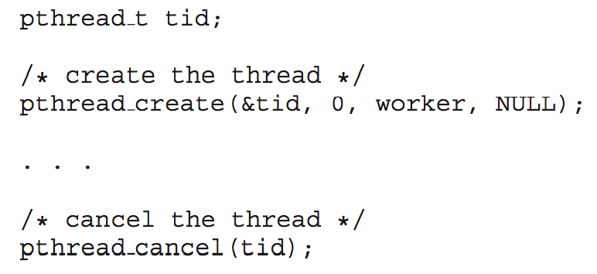
Thread Cancellation
Terminating a thread before it has finished
Thread to be canceled is target thread
Two general approaches:
Asynchronous cancellation terminates the target thread immediately
Deferred cancellation allows the target thread to periodically check if it should be cancelled; The target thread checks a flag to see
Pthread code to create and cancel a thread:
Notes:
-Asynchronous cancellation: troublesome if the thread is in the midst of updating some shared data.
-Deferred cancellation: one thread signals that a thread is to be cancelled. The target thread checks a flag to see if it’s to be cancelled or not. Gives it time to be cancelled safely.
Cancellation occurs when the target thread reaches a cancellation point and a cancel is pending.
-Most of the dangers in performing cancellations deal with properly restoring invariants and freeing shared resources.
For example, a carelessly cancelled thread might leave a mutex (mutual lock) in a locked state, leading to a deadlock. Or it might leave a region of memory allocated with no way to identify it and therefore no way to free it.

Slide 42
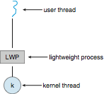
Scheduler Activations
Both M:M and Two-level models require communication to maintain the appropriate number of kernel threads allocated to the application
Typically use an intermediate data structure between user and kernel threads – lightweight process (LWP)
Appears to be a virtual processor on which process can schedule user thread to run
Each LWP attached to kernel thread
How many LWPs to create? (for cpu bound we need less lwp as compare to I/O bound)
Notes:
-An application may require any number of LWPs to run efficiently. Consider a CPU-bound application running on a single processor. In this scenario, only one thread can run at at a time, so one LWP is sufficient. An application that is I/O-intensive may require multiple LWPs to execute, however. Typically, an LWP is required for each concurrent blocking system call. Suppose, for example, that five different file-read requests occur simultaneously. Five LWPs are needed, because all could be waiting for I/O completion in the kernel. If a process has
only four LWPs, then the fifth request must wait for one of the LWPs to return from the kernel.

Slide 43
Operating System Examples
Windows Threads
Linux Threads
Java threads
Notes:
43

Slide 44
Windows Threads
Windows implements the Windows API – primary API for Win 98, Win NT, Win 2000, Win XP, and Win 7
Implements the 1:1 mapping.
Each thread contains
A thread id
Register set representing state of processor
Separate user and kernel stacks for when thread runs in user mode or kernel mode

Slide 45
Windows Threads (Cont.)
The primary data structures of a thread include:
ETHREAD (executive thread block) – in kernel space; includes pointer to process to which thread belongs and to KTHREAD
KTHREAD (kernel thread block) – in kernel space; scheduling and synchronization info, kernel-mode stack, pointer to TEB
TEB (thread environment block) – in user space; thread id, user-mode stack, thread-local storage

Slide 46
Windows Threads Data Structures
Notes:
-ETHREAD and KTHREAD data structures in kernel space and only accessible to kernel.
TEB in user space and accessed when thread running in user mode.

Slide 47
Linux Threads
Linux refers to them as tasks rather than threads
Thread creation is done through clone()system call
clone()allows a child task to share the address space of the parent task (process)
Notes:
Linux does not distinguish between processes and threads. In fact, Linux uses the term task —rather than process or thread— when referring to a flow of control within a program.
-clone() is a system call on the Linux kernel related to multithreading. In practice, one should try to avoid calling clone() directly, but instead use a threading library (such as pthreads) which use clone() when starting a thread (such as during a call to pthread_create()). Preferably, use fork() to create new processes or pthread_create() to create threads.
The varying level of sharing is possible because of the way a task is represented in the Linux kernel. A unique kernel data structure (specifically, struct task struct) exists for each task in the system. This data structure, instead of storing data for the task, contains pointers to other data structures where these data are stored—for example, data structures that represent the list of open files, signal-handling information, and virtual memory.

Slide 48
Thread scheduling
When a thread is created, it inherits its priority from the thread that created it. setPriority method can be used to modify a thread’s priority at any time after its execution . Thread priorities range between MIN_PRIORITY and MAX_PRIORITY.
Executes the thread with highest priority.
If two threads of the same priority are waiting for the CPU, the scheduler arbitrarily chooses one of them to run. The chosen thread runs until one of the following conditions is true:
A higher priority thread becomes runnable.
It yields or its run method exits.
On systems that support time-slicing, its time allotment has expired.
Then the second thread is given a chance to run
Notes:
Only when that thread stops, yields, or becomes Not Runnable will a lower-priority thread start executing

Slide 49
Thread Scheduling
Distinction between user-level and kernel-level threads
When threads supported, threads scheduled, not processes
Many-to-one and many-to-many models, thread library schedules user-level threads to run on LWP
Known as process-contention scope (PCS) since scheduling competition is within the process
Typically done via priority set by programmer
Kernel thread scheduled onto available CPU is system-contention scope (SCS) – competition among all threads in system
Process contention scope: just compete with other threads in the same process vs System Contention Scope where they compete with threads in other processes.
Notes:
-A lightweight process is a schedulable entity that the kernel is aware of. It’s a data structure in between user level and kernel level thread. The user-level thread library sees it as a virtual processor. It can be thought of as an abstraction of a kernel thread. Hence, user threads are implemented by a library that utilises underlying kernel-supported threads of control, called lightweight processes (LWPs).
-Process contention scope (PCS), sometimes called local contention scope: specifies that the thread will be scheduled against all other local contention scope threads in the process. A process-contention-scope user thread is a user thread that shares a kernel thread with other process-contention-scope user threads in the process. All user threads in an M:1 thread model have process contention scope. Actual scheduling of the kernel thread on the CPU is done by OS using system contention scope.
-System contention scope (SCS), sometimes called global contention scope: specifies that the thread will be scheduled against all other threads in the system and is directly mapped to one kernel thread. All user threads in a 1:1 thread model have system contention scope (Windows XP, Linux).

Slide 50
Java threads
Methods:
wait( ) tells the calling thread to give up and go to sleep until some other thread enters and calls notify( ).
notify( ) wakes up the first thread that called wait( ) on the same object.
notifyAll( ) wakes up all the threads that called wait( ) on the same object.
The highest priority thread will run first.

Slide 51
Controlling java threads
start(): begins a thread running
wait() and notify(): for synchronization
_.stop(): kills a specific thread (deprecated)
_.suspend() and resume(): deprecated
_.join(): wait for specific thread to finish
_.setPriority(): 0 to 10 (MIN_PRIORITY to MAX_PRIORITY); 5 is default (NORM_PRIORITY)

Slide 52
Java Thread Scheduling
highest priority thread runs
if more than one, arbitrary
yield(): current thread gives up processor so another of equal priority can run
if none of equal priority, it runs again
sleep(msec): stop executing for set time
lower priority thread can run

Slide 53
Multiple-Processor Scheduling
CPU scheduling more complex when multiple CPUs are available
Homogeneous processors within a multiprocessor
Asymmetric multiprocessing – only one processor accesses the system data structures
Symmetric multiprocessing (SMP) – each processor is self-scheduling, all processes in common ready queue, or each has its own private queue of ready processes
Currently, most common
Processor affinity – process has affinity for processor on which it is currently running
soft affinity
hard affinity
Notes:
-Consider what happens to cache memory when a process has been running on a specific processor. The data most recently accessed by the process populate the cache for the processor. As a result, successive memory accesses by the process are often satisfied in cache memory. Now consider what happens if the process migrates to another processor. The contents of cache memory must be invalidated for the first processor, and the cache for the second processor must be repopulated. Because of the high cost of invalidating and repopulating caches, most SMP systems try to avoid migration of processes from one processor to another and instead attempt to keep a process running on the same processor. This is known as processor affinity—that is, a process has an affinity for the processor on which it is currently running.
- When an operating system has a policy of attempting to keep a process running on the same processor—but not guaranteeing that it will do so—we have a situation known as soft affinity. Here, the operating system will attempt to keep a process on a single processor, but it is possible for a process to migrate between processors. In contrast, some systems provide system calls that support hard affinity, thereby allowing a process to specify a subset of processors on which it may run. Many systems provide both soft and hard affinity. For example, Linux implements soft affinity, but it also provides the sched_setaffinity () system call, which supports hard affinity.

Slide 54
NUMA and CPU Scheduling
Note that memory-placement algorithms can also consider affinity
Notes:
-NUMA = Non-uniform memory access
-If the operating system’s CPU scheduler and memory-placement algorithms work together, then a process that is assigned affinity to a particular CPU can be allocated memory on the board where that CPU resides.

Slide 55
Multiple-Processor Scheduling – Load Balancing
If SMP, need to keep all CPUs loaded for efficiency
Load balancing attempts to keep workload evenly distributed
Push migration – periodic task checks load on each processor, and if found pushes task from overloaded CPU to other CPUs
Pull migration – idle processors pulls waiting task from busy processor
Can work counter to processor affinity
Notes:
-in some systems, an idle processor always pulls a process from a non-idle processor. In other systems, processes are moved only if the imbalance exceeds a certain threshold. This is to retain the benefits of processor affinity.

Slide 56
Multicore Processors
Recent trend to place multiple processor cores on same physical chip
Faster and consumes less power
Multiple threads per core also growing
Takes advantage of memory stall to make progress on another thread while memory retrieve happens
Notes:
- Researchers have discovered that when a processor accesses memory, it spends a significant amount of time waiting for the data to become available. This situation, known as a memory stall, may occur for various reasons, such as a cache miss (accessing data that are not in cache memory).

Slide 57
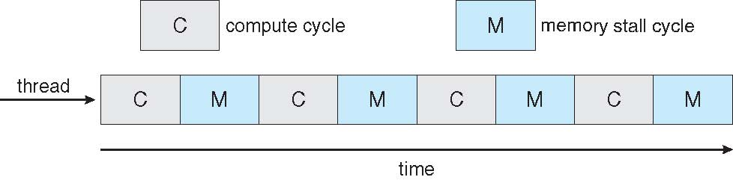

Multithreaded Multicore System
Notes:
-To remedy this situation, many recent hardware designs have implemented multithreaded processor cores in which two (or more) hardware threads are assigned to each core. That way, if one thread stalls while waiting for memory, the core can switch to another thread.

Slide 58
Slide 58 to 62
Java thread examples
Not included in the course but for self study

Slide 59
Java threads
There are two ways to create thread in java;
Implement the Runnable interface (java.lang.Runnable)
By Extending the Thread class (java.lang.Thread)

Slide 60
Creating a thread in Java is done like this:
Thread thread = new Thread();
To start the thread you will call its start() method, like this:
thread.start();

Slide 61
1st method(extend thread class)
The first way to specify what code a thread is to run, is to create a subclass of Thread and override the run() method. The run() method is what is executed by the thread after you call start(). Here is an example:
public class MyThread extends Thread {
public void run()
{
System.out.println("MyThread running");
} }
To create and start the above thread you can do like this:
MyThread myThread = new MyThread();
myThread.start();
The thread ends when the run() method ends, either by normal completion or by throwing an exception.

Slide 62
2nd method(implements runnable interface
The Runnable Interface Signature
public interface Runnable {
void run();
}
Java Runnable example:
public class MyRunnable implements Runnable
{ public void run()
{ System.out.println("MyRunnable running"); } }
To have the run() method executed by a thread, pass an instance of MyRunnable to a Thread in its constructor. Here is how that is done:
Thread thread = new Thread(new MyRunnable());
thread.start();
When the thread is started it will call the run() method of the MyRunnable instance instead of executing it's own run() method. The above example would print out the text "MyRunnable running".

Slide 63
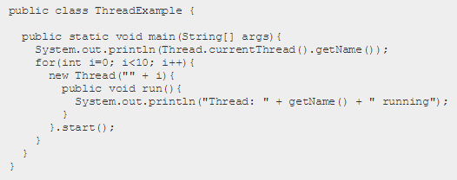
Java Thread Example
First it prints out the name of the thread executing the main() method. Then it starts up 10 threads and give them all a number as name ("" + i). Each thread then prints its name out, and then stops executing.
they may not execute sequentially

